Slide 1
Visual Thinking AI System
Oct 12, 2016
Chuilian Kong
CS 8395 Project 1
Subtitle or catch phrase for the presentation
Notes:
Hello, Here’s my presentation for project1 visual thinking AI system.

Slide 2
Overview
System Design
Visual Recognition
Mental Imagery
Results
Conclusion
Notes:
This is the overview of my presentation, I will first explain how I build this AI system and then I will show you some results and make some conclusions.

Slide 3
System Design
Visual Recognition
Mental Imagery
Color Classification
Fuzzification
Finding Components
Shape Recognition
Attach pivots & strings
Mental Model
System Framework
Reasoning Rules
Notes:
My AI system can be divided into two parts: the first part is called visual recognition, in this part, the system will analysis the input picture, recognizing the shapes and colors and then build a mental model of the picture. The second part is called mental imagery, in this part, the system will use the mental model to do some inductive reasoning based on given rules.

Slide 4
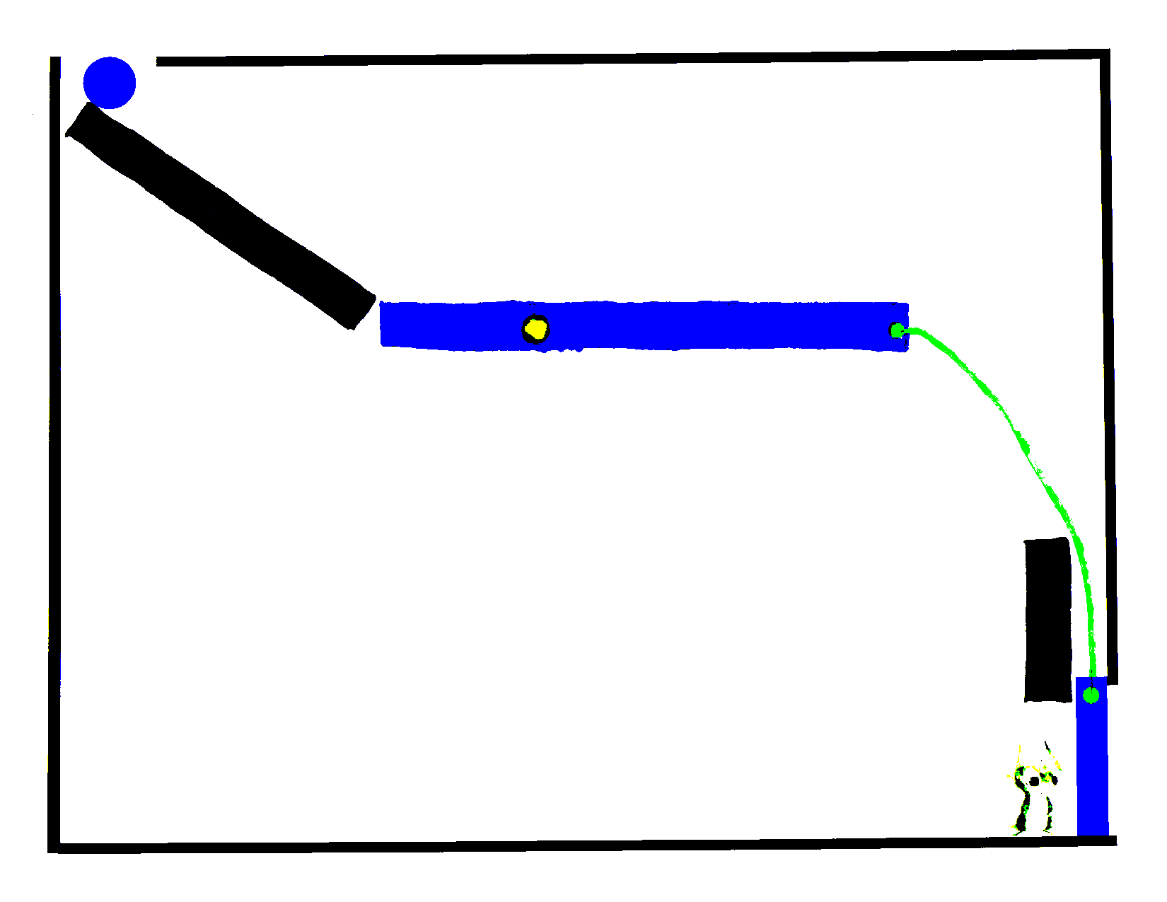
Visual Recognition – Color Classification
Five basic colors
Black
Blue
Yellow
Green
White
Euclid Distance
Key assumptions
Add your assumptions here
Notes:
The first step of visual recognition is to classify colors. Since the system will take a hand drawing picture as input, so there might be many different RGB value for the same color, and our system only care about five basic colors: black, blue, yellow, green, white, so the first thing we need to do is to classify colors into these five category. And the method I used here is to calculate Euclid distance between the RGB vectors of the color pixels and the basic colors, and find the nearest basic color to be the pixel’s color label.

Slide 5
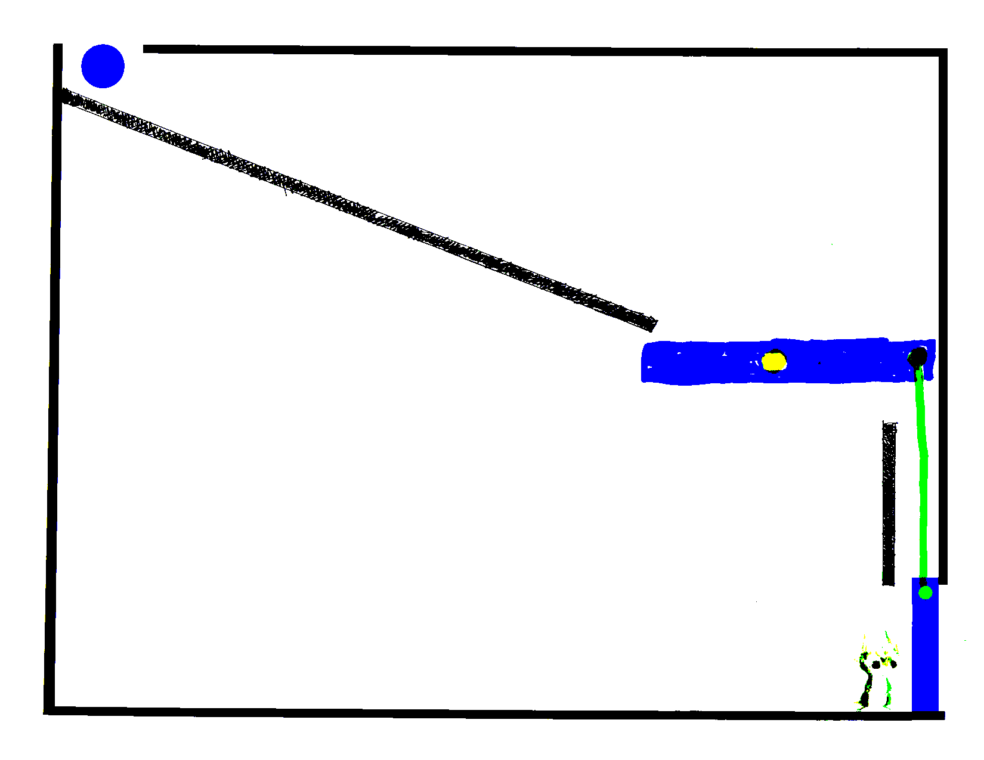
Visual Recognition – Fuzzification
alleviate the impact of hand drawing flaws for better recognition
Key assumptions
Add your assumptions here
reduce image resolution for better efficiency
Notes:
The second step of visual recognition is what I called fuzzification. This is a process that we deliberately blur the input picture. The major purpose of doing this, is to eliminate some of hand drawing flaws, such as many small holes in an object, and after fuzzfication, this picture will look like this. Additionally, this fuzzfication process will reduce the image resolution, thus the remaining process can be implement faster. So the way I do this fuzzification is quite simple, I just separate the picture into squares and find the dominant color within the square to be the square’s color.

Slide 6
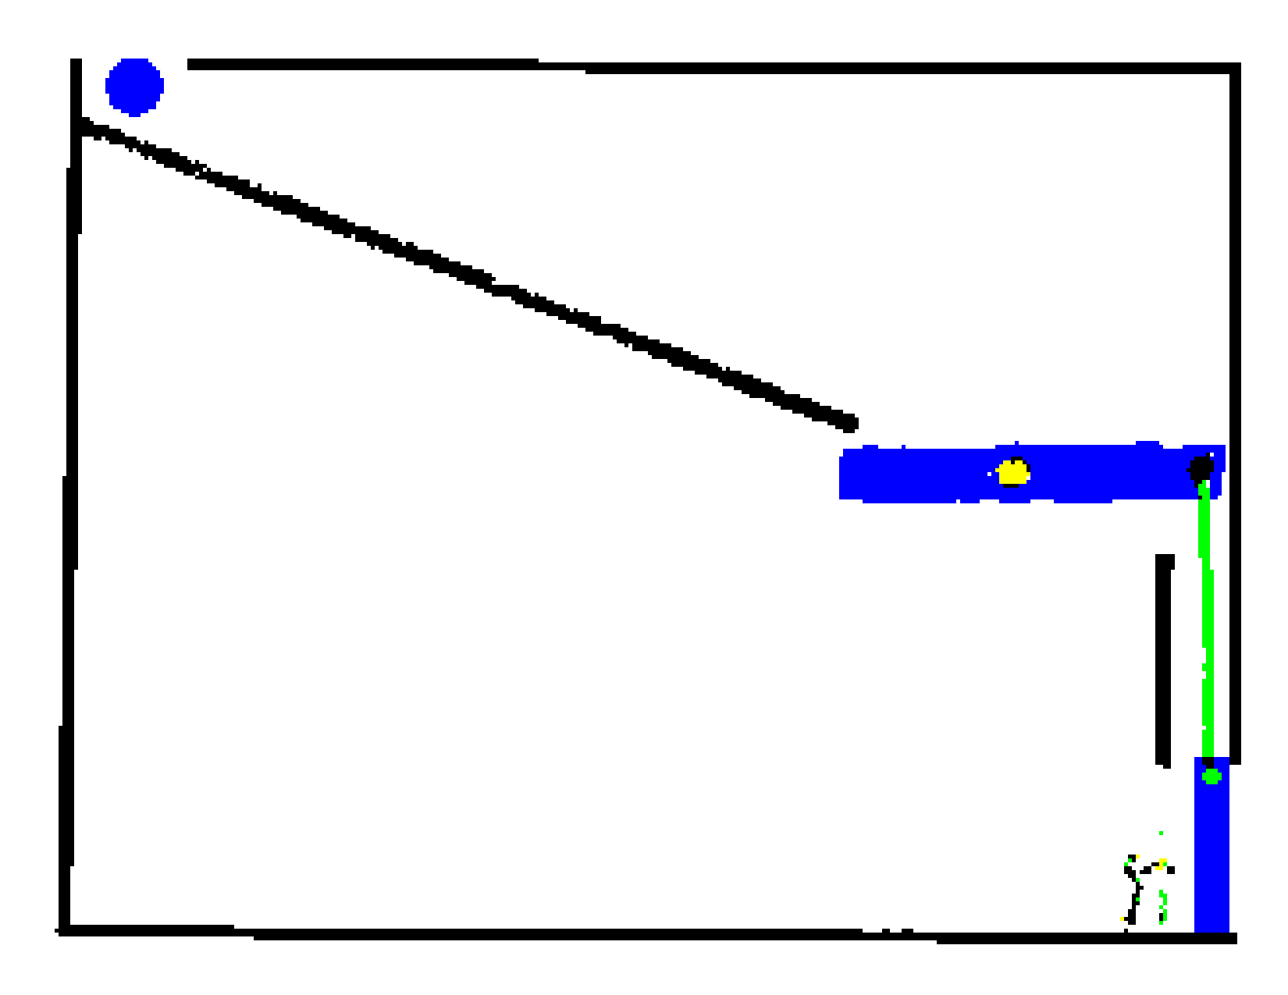
Visual Recognition – Fuzzification
alleviate the impact of hand drawing flaws for better recognition
Key assumptions
Add your assumptions here
reduce image resolution for better efficiency
Notes:
The second step of visual recognition is what I called fuzzification. This is a process that we deliberately blur the input picture. The major purpose of doing this, is to eliminate some of hand drawing flaws, such as many small holes in an object, and after fuzzfication, this picture will look like this. Additionally, this fuzzfication process will reduce the image resolution, thus the remaining process can be implement faster. So the way I do this fuzzification is quite simple, I just separate the picture into squares and find the dominant color within the square to be the square’s color.

Slide 7
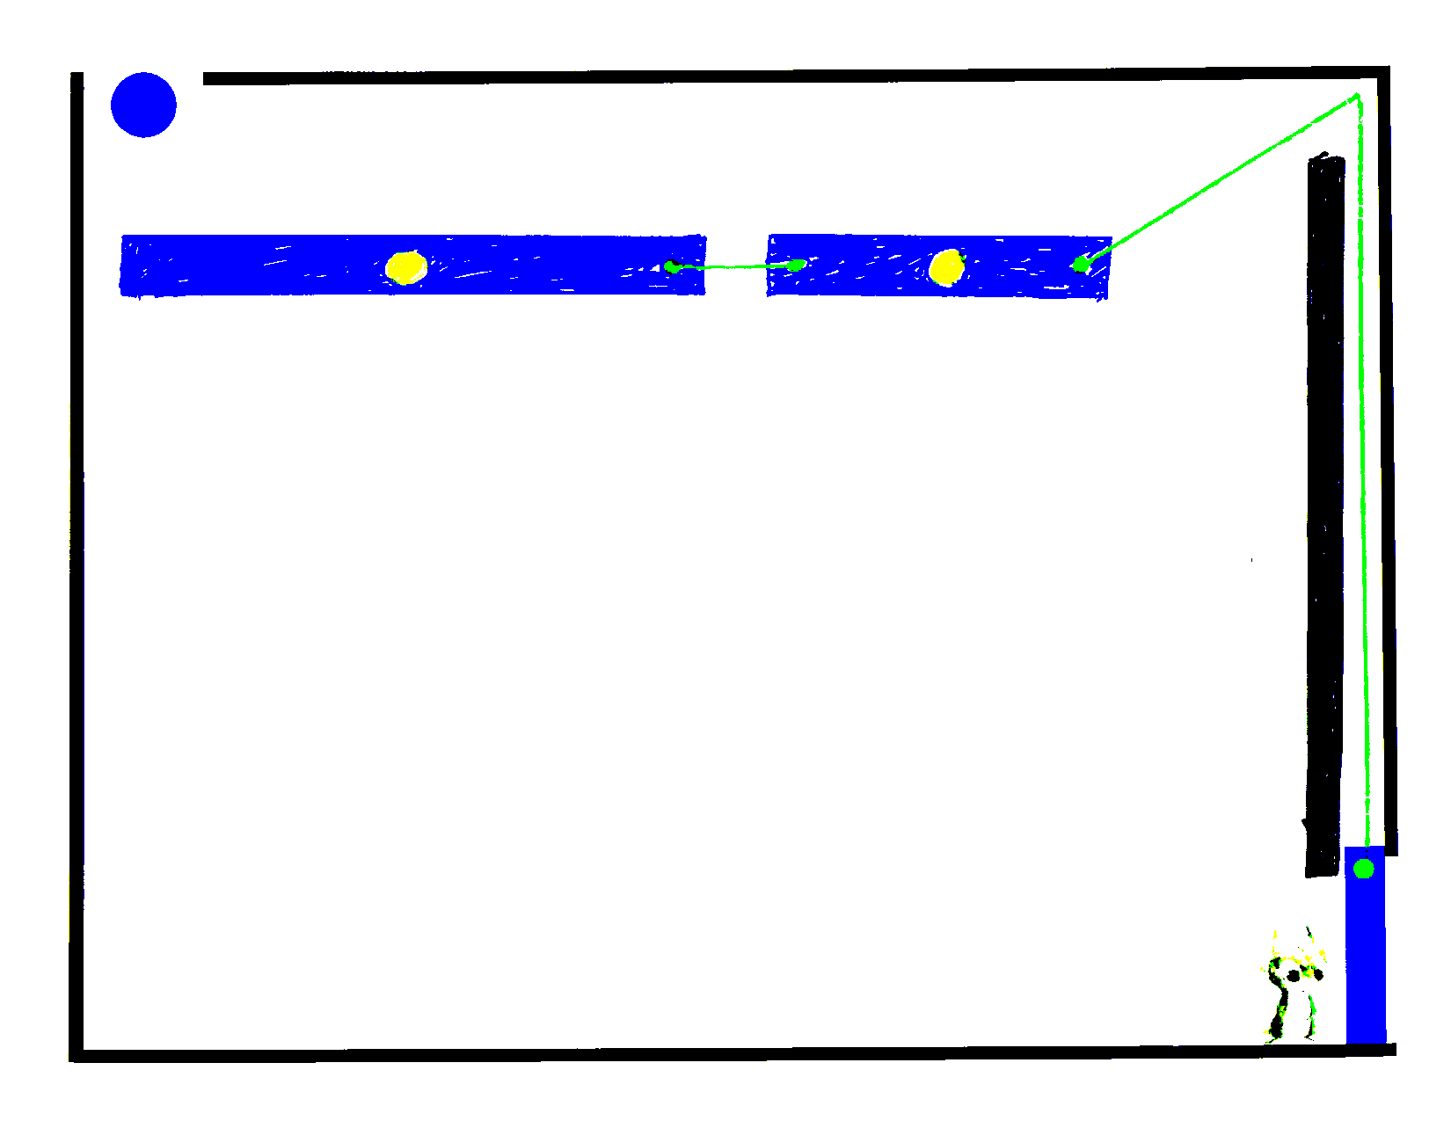
Visual Recognition– Connected components
DFS algorithm
Discard small objects
Key assumptions
Add your assumptions here
Notes:
And the next step, is pretty much many of you have done, using the DFS to find the connected components and mark them as different objects. And I discarded those objects that have really small size, because generally those small objects are minor drawing flaws or a part of this broken mouse. Here is an example.

Slide 8
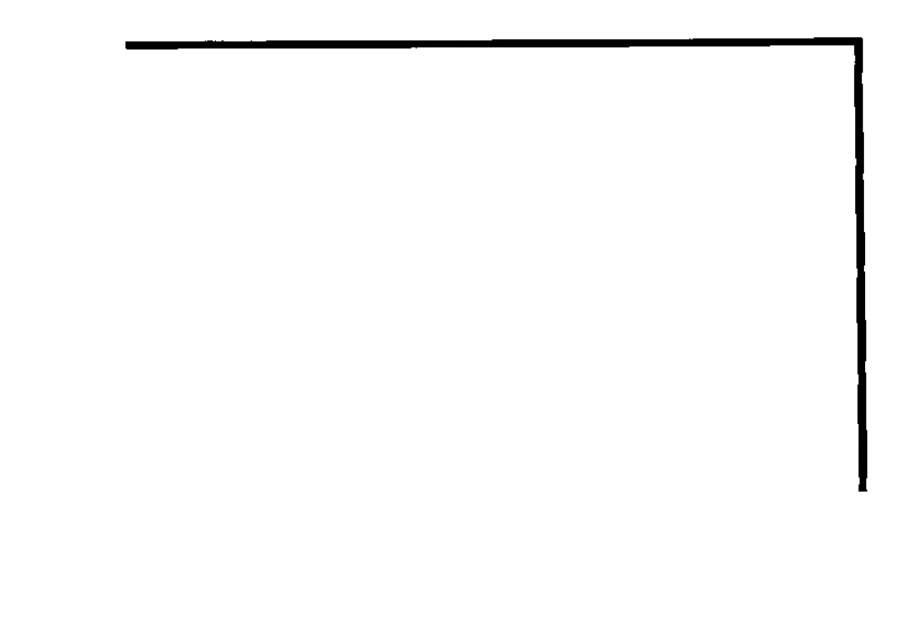
Visual Recognition– Connected components
DFS
Discard small objects
Key assumptions
Add your assumptions here
Notes:
And the next step, is pretty much many of you have done, using the DFS to find the connected components and mark them as different objects. And I discarded those objects that have really small size, because generally those small objects are minor drawing flaws or a part of this broken mouse. Here is an example.

Slide 9
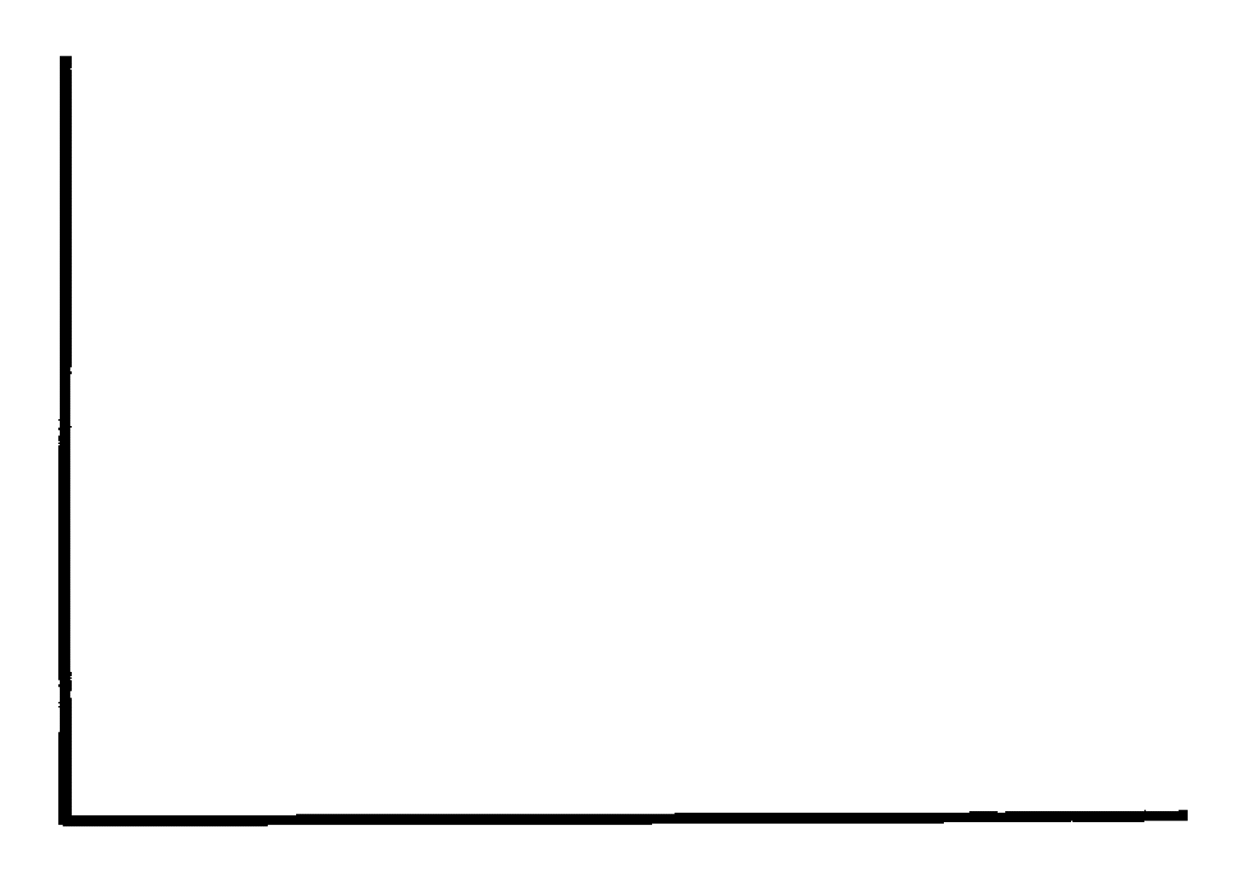
Visual Recognition– Connected components
DFS
Discard small objects
Key assumptions
Add your assumptions here
Notes:
And the next step, is pretty much many of you have done, using the DFS to find the connected components and mark them as different objects. And I discarded those objects that have really small size, because generally those small objects are minor drawing flaws or a part of this broken mouse. Here is an example.

Slide 10

Visual Recognition– Connected components
DFS
Discard small objects
Key assumptions
Add your assumptions here
Notes:
And the next step, is pretty much many of you have done, using the DFS to find the connected components and mark them as different objects. And I discarded those objects that have really small size, because generally those small objects are minor drawing flaws or a part of this broken mouse. Here is an example.

Slide 11

Visual Recognition– Connected components
DFS
Discard small objects
Key assumptions
Add your assumptions here
Notes:
And the next step, is pretty much many of you have done, using the DFS to find the connected components and mark them as different objects. And I discarded those objects that have really small size, because generally those small objects are minor drawing flaws or a part of this broken mouse. Here is an example.

Slide 12

Visual Recognition– Connected components
DFS
Discard small objects
Key assumptions
Add your assumptions here
Notes:
And the next step, is pretty much many of you have done, using the DFS to find the connected components and mark them as different objects. And I discarded those objects that have really small size, because generally those small objects are minor drawing flaws or a part of this broken mouse. Here is an example.

Slide 13

Visual Recognition– Connected components
DFS
Discard small objects
Key assumptions
Add your assumptions here
Notes:
And the next step, is pretty much many of you have done, using the DFS to find the connected components and mark them as different objects. And I discarded those objects that have really small size, because generally those small objects are minor drawing flaws or a part of this broken mouse. Here is an example.

Slide 14

Visual Recognition– Connected components
DFS
Discard small objects
Key assumptions
Add your assumptions here
Notes:
And the next step, is pretty much many of you have done, using the DFS to find the connected components and mark them as different objects. And I discarded those objects that have really small size, because generally those small objects are minor drawing flaws or a part of this broken mouse. Here is an example.

Slide 15

Visual Recognition– Shape recognition
Center point
Orientation
Key assumptions
Add your assumptions here
Notes:
Here for shape recognition, I used a matlab function called regionpros. This function returned a list of information about the given region, and based on these information I can calculate the center point, orientation of the region and I can even determine its shape and position. Here are some results.

Slide 16

Visual Recognition– Shape recognition
Center point
Orientation
Key assumptions
Add your assumptions here
Notes:
Here for shape recognition, I used a matlab function called regionpros. This function returned a list of information about the given region, and based on these information I can calculate the center point, orientation of the region and I can even determine its shape and position.

Slide 17

Visual Recognition– Shape recognition
Center point
Orientation
Key assumptions
Add your assumptions here
Notes:
Here for shape recognition, I used a matlab function called regionpros. This function returned a list of information about the given region, and based on these information I can calculate the center point, orientation of the region and I can even determine its shape and position.

Slide 18
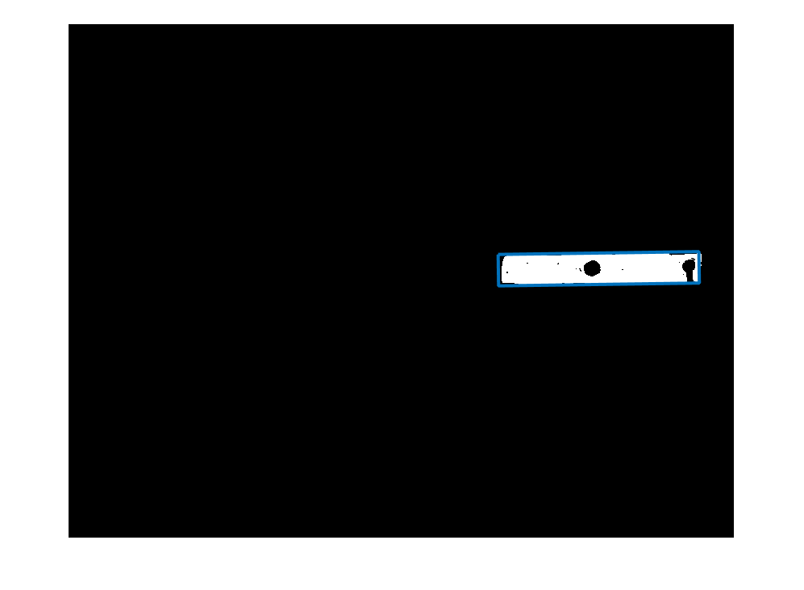
Visual Recognition– Shape recognition
Center point
Orientation
Key assumptions
Add your assumptions here
Notes:
Here for shape recognition, I used a matlab function called regionpros. This function returned a list of information about the given region, and based on these information I can calculate the center point, orientation of the region and I can even determine its shape and position.

Slide 19

Visual Recognition– Shape recognition
Center point
Orientation
Key assumptions
Add your assumptions here
Notes:
Here for shape recognition, I used a matlab function called regionpros. This function returned a list of information about the given region, and based on these information I can calculate the center point, orientation of the region and I can even determine its shape and position.

Slide 20
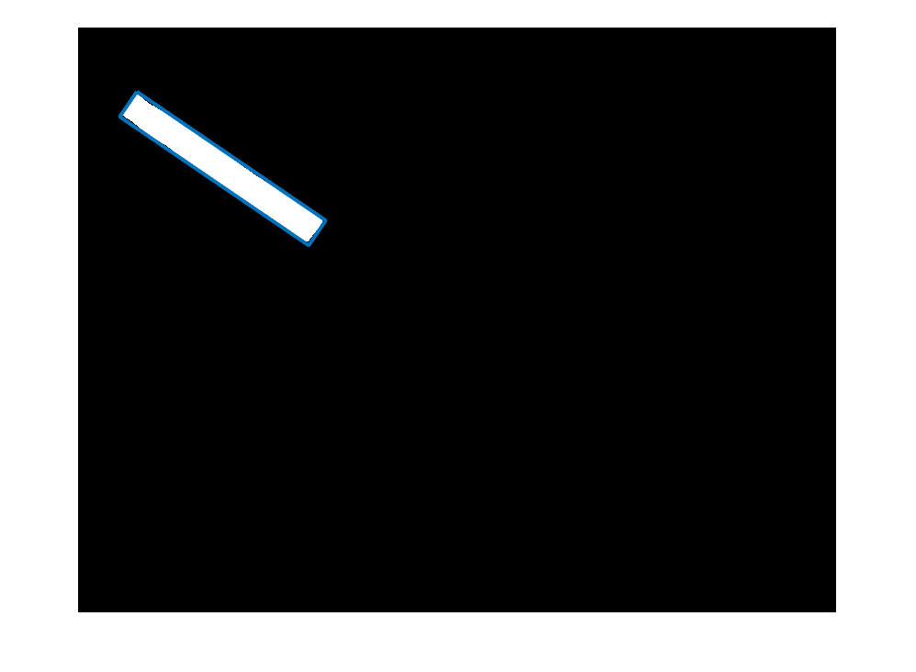
Visual Recognition– Shape recognition
Center point
Orientation
Key assumptions
Add your assumptions here
Notes:
Here for shape recognition, I used a matlab function called regionpros. This function returned a list of information about the given region, and based on these information I can calculate the center point, orientation of the region and I can even determine its shape and position.

Slide 21

Visual Recognition– Shape recognition
Center point
Orientation
Key assumptions
Add your assumptions here
Notes:
Here for shape recognition, I used a matlab function called regionpros. This function returned a list of information about the given region, and based on these information I can calculate the center point, orientation of the region and I can even determine its shape and position.

Slide 22

Visual Recognition– Shape recognition
Center point
Orientation
Key assumptions
Add your assumptions here
Notes:
Here for shape recognition, I used a matlab function called regionpros. This function returned a list of information about the given region, and based on these information I can calculate the center point, orientation of the region and I can even determine its shape and position.

Slide 23
Visual Recognition – attach pivot & string
Pivot (yellow)
String (green)
If it is within a region of a blue object.
Center point
If it is within a region of a blue object.
Touching point
Notes:
Finally, the system will attach pivot and string to the blue objects. The method here is quite simple, I just see, for each yellow or green object, if it is within a region of a blue object, and if it is, for yellow object, it passes its center point to blue object as the pivot of blue object, and for green object, it passes the touching point to the blue object.

Slide 24
Mental Imagery – Mental Model
Object Information
Color, Id, A logic matrix of all pixels of this object, Shape information, State information
Shape Information
State Information
Shape
Center point
Width, height, orientation
radius
Pivot point
String touching point, string to ?
Stability, potential moving direction
Notes:
The mental model of my AI system is a list of object information including its shape, position and state.

Slide 25
Mental Imagery – System Framework
Constructing mental model
Initialize unstable object and moving direction.
Loop
For each unstable object
move or rotate them for one step
Check if there is a collision
Collision: add appropriate updated state to update list
Update states according to the list
Take a picture
Check if one of the object reaches its terminate state.
Notes:
The framework of my AI system is pretty simple: first, the system will read a picture and then build a mental model of this picture by represent objects to a list of properties. Then initialize the unstable object and their moving directions. Then enter a loop, for each round, the system will check all the movable objects to find if they are unstable, and either move or rotate them for one step, then check if there is a collision after the action, if there is, according to some basic rules, calculate and add the corresponding updated state to update list. After all unstable objects moved for one step, update states based on the list. Take a picture. Then check if there is an object that reaches its terminate state, if there is, terminate the system, else start a another round.

Slide 26
Mental Imagery – Reasoning Rules
Two major assumptions:
All strings are extremely weak.
All blue objects with a pivot are initially stable.
Notes:
So the reasoning rules are pretty complicated, I will not explain it in detail. But I have to mention two major assumption I make here: the first assumption is about string. I assume all strings are extremely weak so that any passing force will break it, so the string will only take effect once, then it will break, avoiding complex interaction between the two sides of object. The second assumption is about initial states, all blue object with a pivot are initially stable and all blue object without a pivot are unstable and have a potential moving direction toward the earth.

Slide 27
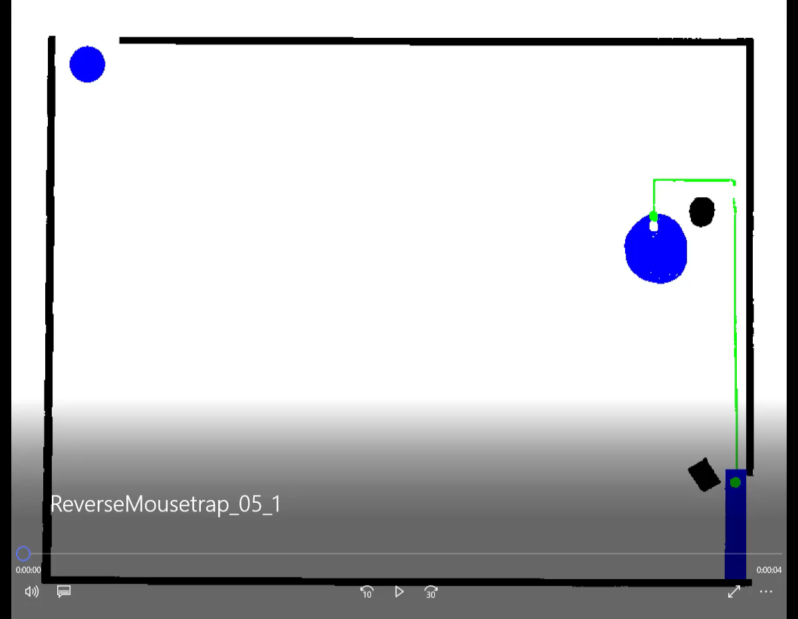
Result -- Picture 5
Notes:
Here is the result for picture 5, as you can see, I didn’t extend or compress the string, because according to my assumption, the string will not affect the system after it passed a force once, so I don’t care the state of a string after it takes the first effect.

Slide 28
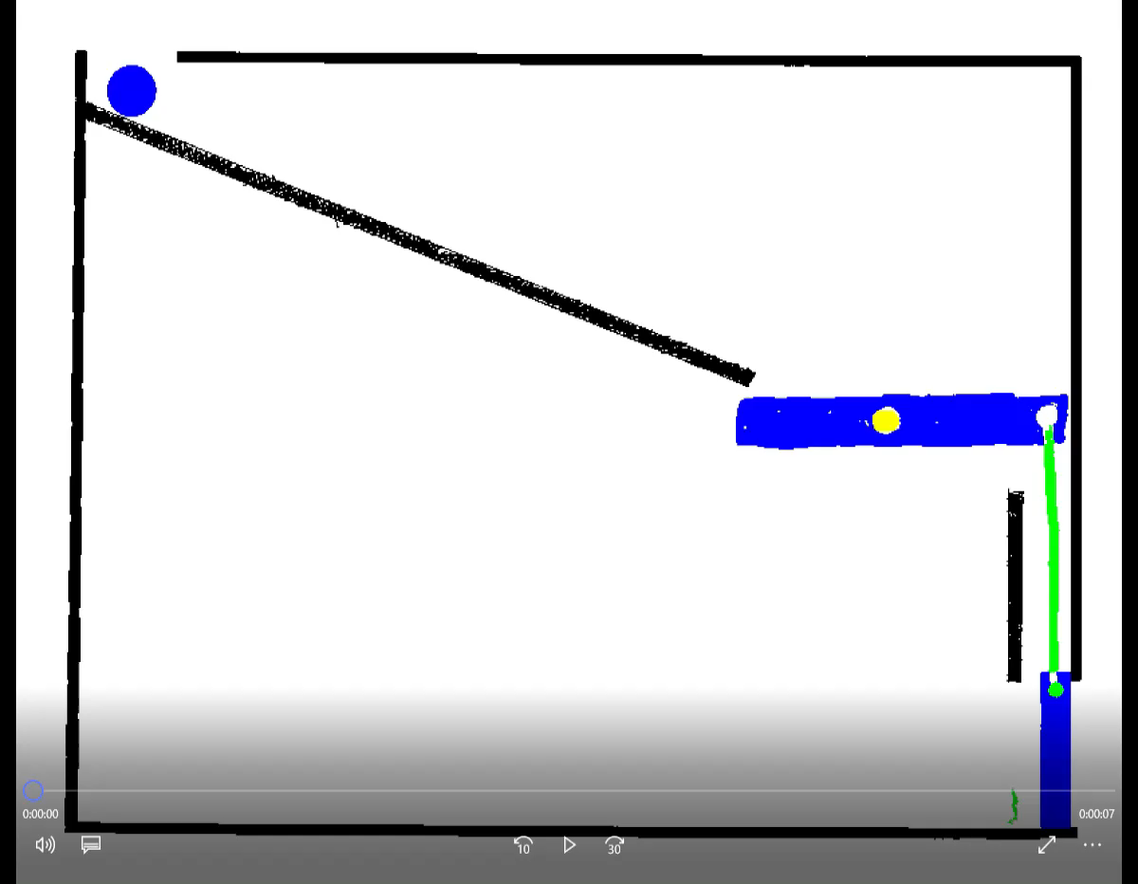
Result -- Picture 7

Slide 29
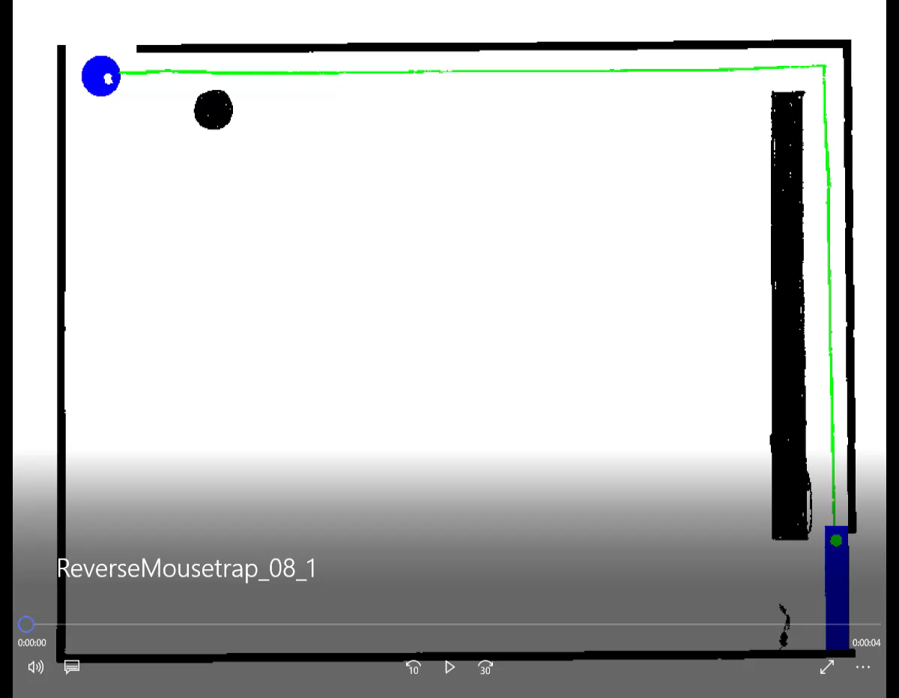
Result -- Picture 8

Slide 30
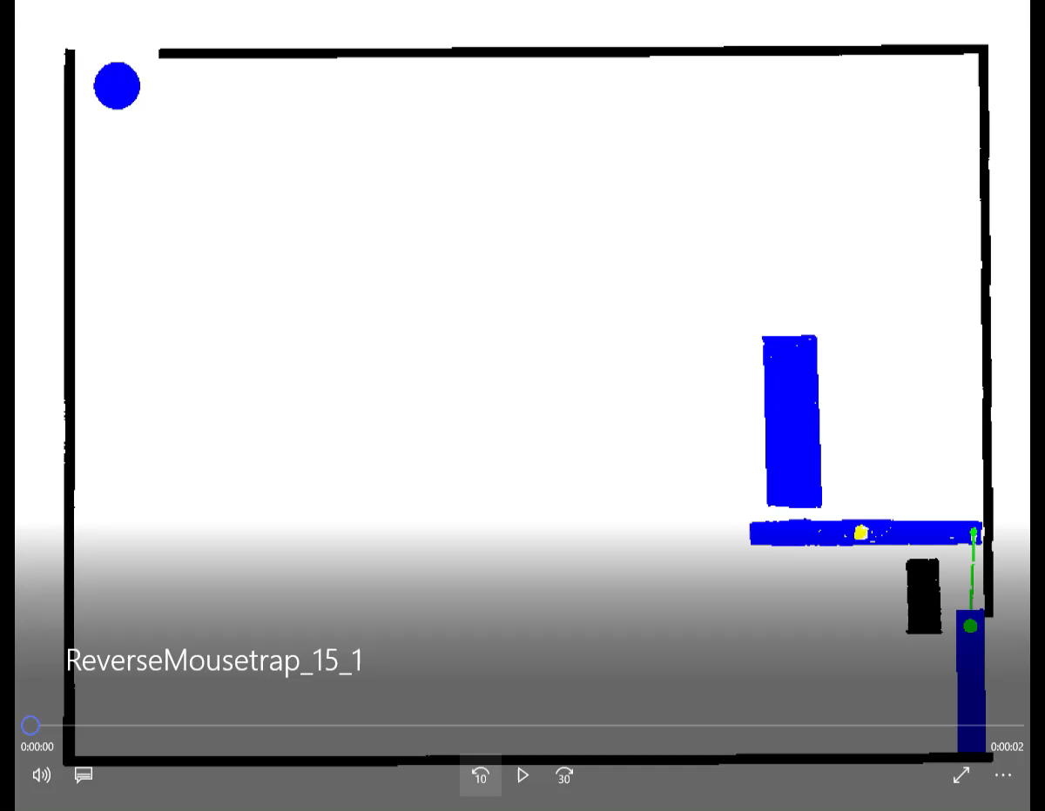
Result -- Picture 15

Slide 31
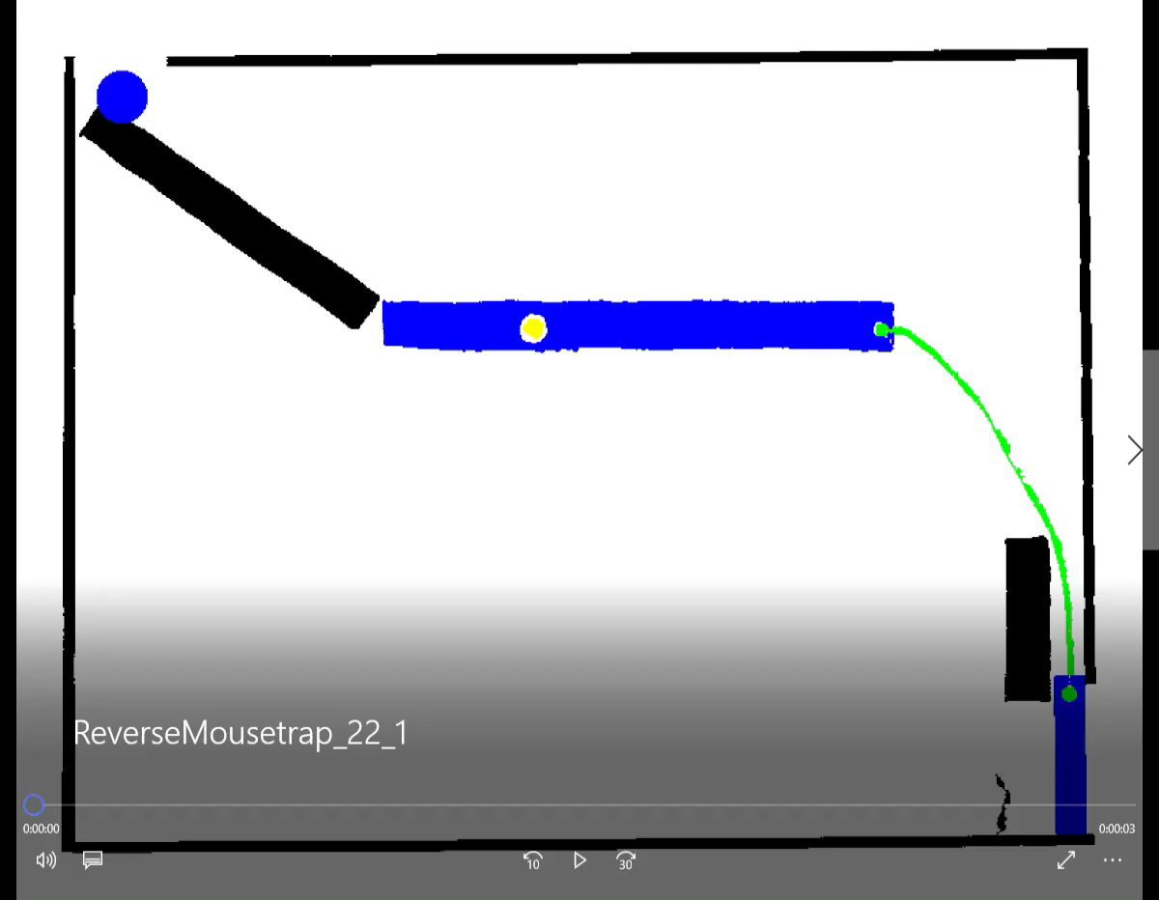
Result -- Picture 22

Slide 32
Conclusion
No time for conclusion!

Slide 33
Questions & Discussion

